Slide 1
MODULE II
Switching

Slide 2

Simple Switched Network

Slide 3
Switching Networks
Long distance transmission is typically done over a network of switched nodes
Nodes not concerned with content of data
End devices are stations
  Computer, terminal, phone, etc.
communications network -A collection of nodes.
Data routed by being switched from node to node

Slide 4
Nodes
Nodes may connect to other nodes only, or to stations and other nodes
Node to node links usually multiplexed.
Node-station links are generally dedicated point-to-point links.
Network is usually partially connected
  Some redundant connections are desirable for reliability

Slide 5
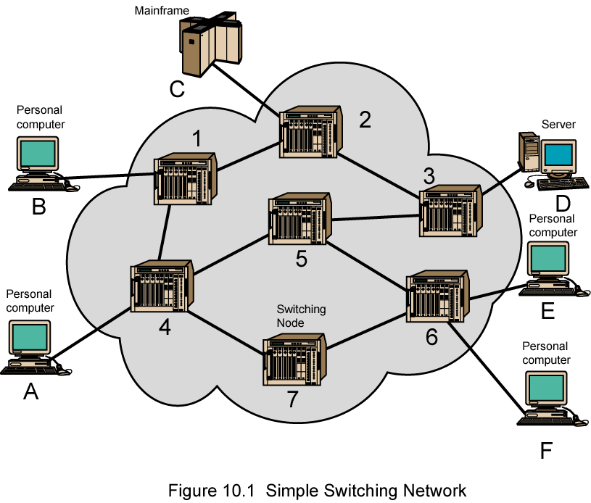
Simple Switched Network

Slide 6

Taxonomy of switched networks

Slide 7
Circuit Switching(Physical Layer)
A circuit-switched network consists of a set of switches connected by physical links.
A connection between two stations is a dedicated path made of one or more links. However, each connection uses only one dedicated channel on each link.
Each link is normally divided into n channels by using FDM or TDM

Slide 8

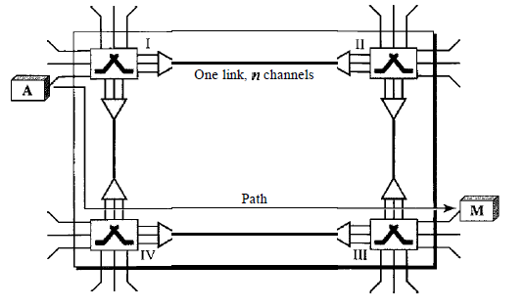
A trivial circuit-switched network

Slide 9
Circuit switching takes place at the physical layer.
Before starting communication, the stations must make a reservation for the resources to be used during the communication. These resources, such as channels (bandwidth in FDM and time slots in TDM), switch buffers, switch processing time, and switch input/output ports, must remain dedicated during the entire duration of data transfer until the teardown phase.
Data transferred between the two stations are not packetized (physical layer transfer of the signal). The data are a continuous flow sent by the source station and received y the destination station, although there may be periods of silence.
There is no addressing involved during data transfer. The switches route the data based on their occupied band (FDM) or time slot (TDM).

Slide 10
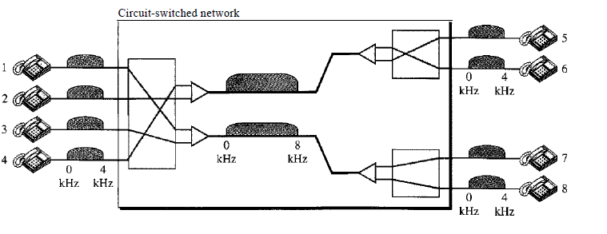
Example
As a trivial example, let us use a circuit-switched network to connect eight telephones in a small area. Communication is through 4-kHz voice channels. We assume that each link uses FDM to connect a maximum of two voice channels. The bandwidth of each link is then 8 kHz. Figure 8.4
shows the situation. Telephone 1 is connected to telephone 7; 2 to 5; 3 to 8; and 4 to 6. Of course the situation may change when new connections are made. The switch controls the connections.

Slide 11
Circuit Switching
Dedicated communication path between two stations
Three phases
  Establish
  Transfer
  Disconnect
Must have switching capacity and channel capacity to establish connection
Must have intelligence to work out routing

Slide 12
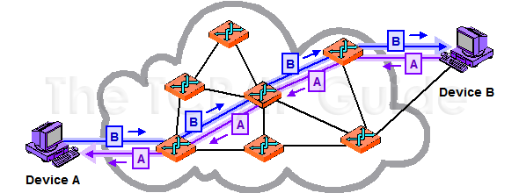
Circuit Switching

Slide 13
Circuit Switching
Inefficient
  Channel capacity dedicated for duration of connection
  If no data, capacity wasted
Set up (connection) takes time
Once connected, transfer is transparent
Circuit switching designed for voice
  Resources dedicated to a particular call
  Much of the time a data connection is idle
  Data rate is fixed
    Both ends must operate at the same rate

Slide 14
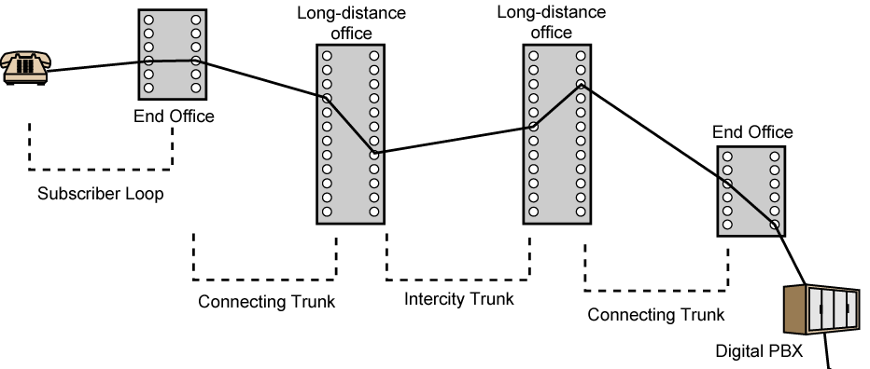
Public Circuit Switched Network

Slide 15
Telecommunication Components
Subscriber
  Devices attached to network
Subscriber line
  The link between the subscriber and the network
  Known as Local Loop or Subscriber loop
  Few km up to few tens of km
Exchange
  Switching centers in the network.
  A switching center that directly supports subscribers is known as an end office.
Trunks
  Branches between exchanges
  Trunks carry multiple voice frequency circuits using either FDM or synchronous TDM

Slide 16
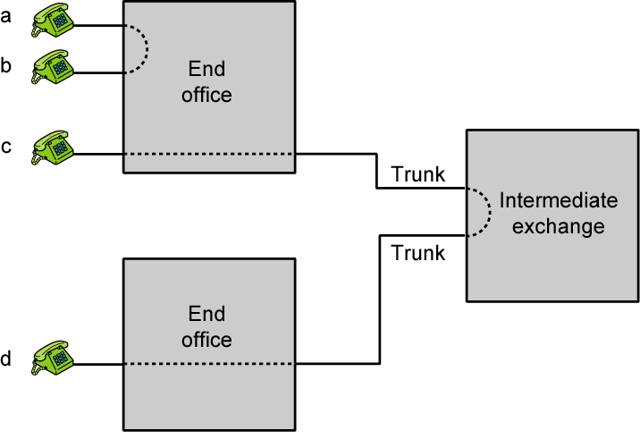
Circuit Establishment

Slide 17
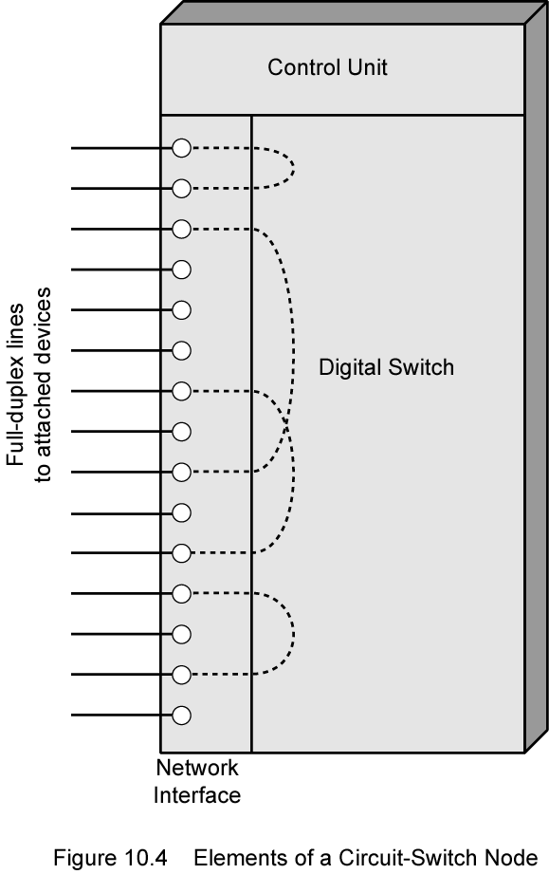
Circuit Switch Elements

Slide 18
Circuit Switching Concepts
Digital Switch
  Provide transparent signal path between devices
Network Interface Element
- represents the functions and hardware needed to connect digital
devices, such as data processing devices and digital telephones.
Control Unit
  Establish connections
    Generally on demand
    Handle and acknowledge requests
    Determine if destination is free
    construct path
  Maintain connection
  Disconnect

Slide 19
Characteristics of Circuit Switching
Blocking
  A network is unable to connect stations because all paths are in use
  Used on voice systems
    Short duration calls
Non-blocking
  Permits all stations to connect (in pairs) at once
  Used for some data connections

Slide 20
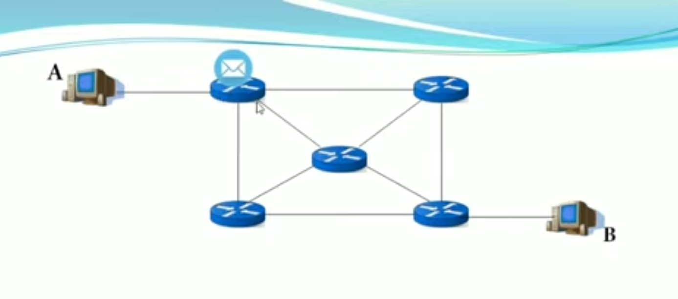
Message switching(Application Layer)
No dedicated path between sender and receiver.
Store and forward.
Not suitable for real time applications

Slide 21


Slide 22
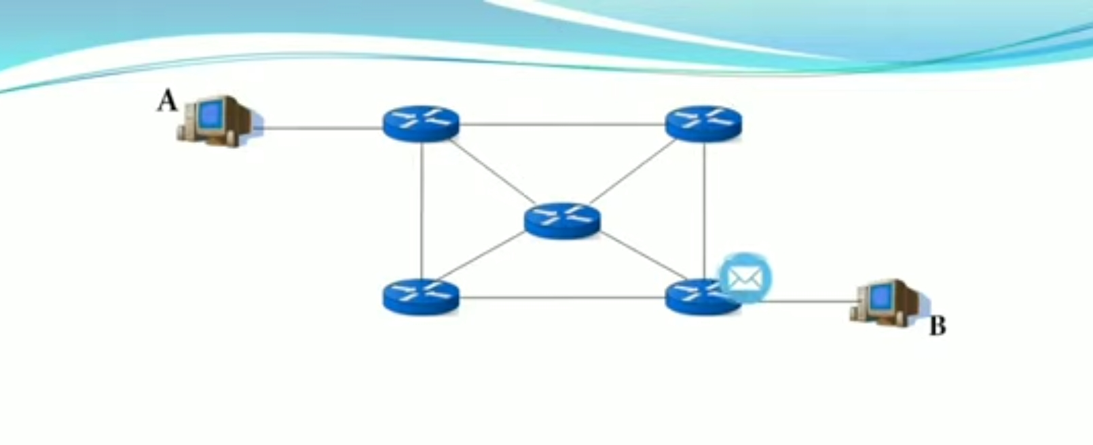

Slide 23
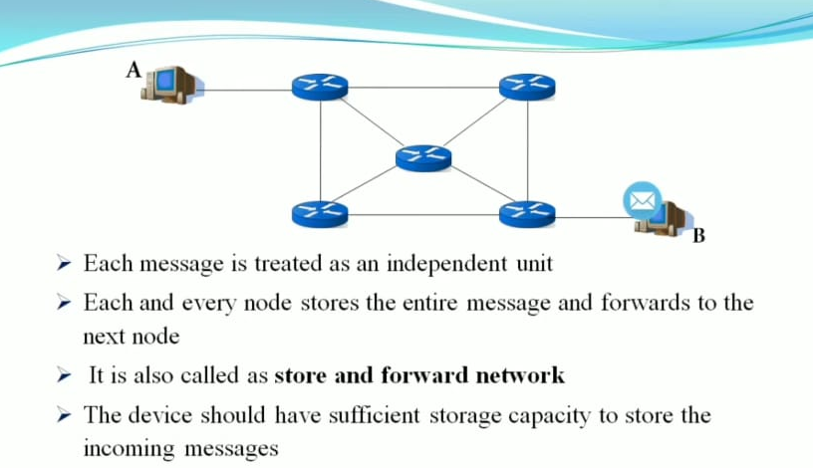

Slide 24
Packet Switching Principles
In a packet-switched network, there is no resource reservation; resources are allocated on demand.
Data transmitted in small packets
  Typically 1000 octets
  Longer messages split into series of packets
  Each packet contains a portion of user data plus some control info
Control info
  Routing (addressing) info
Packets are received, stored briefly (buffered) and past on to the next node

Slide 25
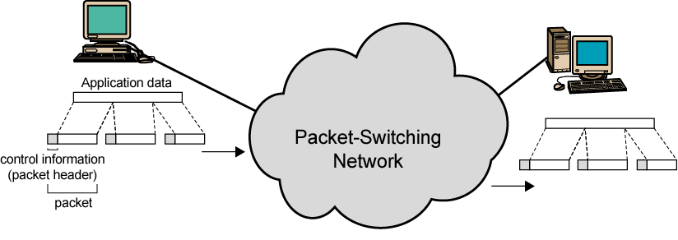
Use of Packets

Slide 26
Advantages
Line efficiency
  Single node to node link can be shared by many packets over time
  Packets queued and transmitted as fast as possible
Data rate conversion
  Each station connects to the local node at its own speed
  Nodes buffer data if required to equalize rates
Packets are accepted even when network is busy
  Delivery may slow down
Priorities can be used

Slide 27
Packet Switching Technique
Station breaks long message into packets
Packets sent one at a time to the network
Packets handled in two ways
  Datagram Approach
  Virtual circuit Approach

Slide 28
Datagram Approach(Network Layer)
Datagram switching is normally done at the network layer
Packets in this approach are referred to as datagrams.
Each packet treated independently
Packets can take any practical route
Packets may arrive out of order
Packets may go missing
Up to receiver to re-order packets and recover from missing packets.
A switch in a datagram network uses a routing table that is based on the destination address.

Slide 29

A datagram network with four switches

Slide 30
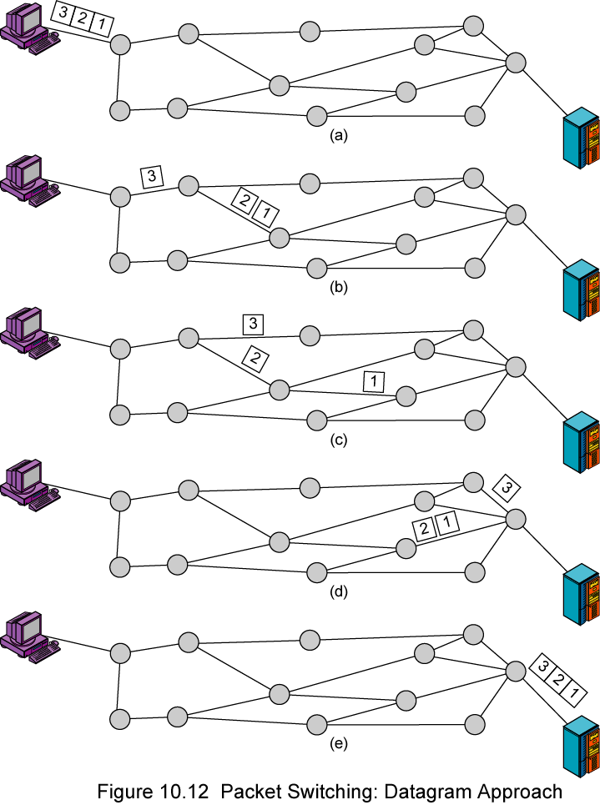
Datagram
Diagram

Slide 31
Virtual Circuit Approach(DataLink Layer)
Preplanned route established before any packets sent
Call request and call accept packets establish connection (handshake)
Each packet contains a virtual circuit identifier(VCI) instead of destination address
No routing decisions required for each packet
Clear request to drop circuit
Not a dedicated path

Slide 32
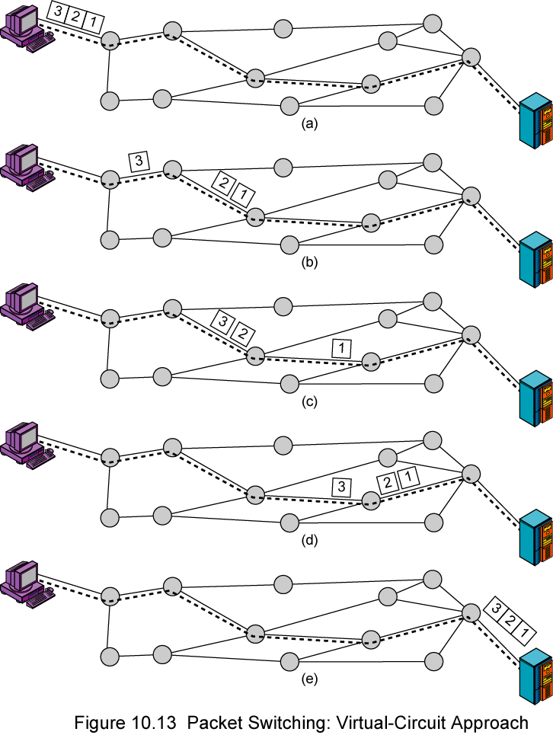
Virtual
Circuit
Diagram

Slide 33
Virtual Circuits v Datagram
Virtual circuits
  Network can provide sequencing and error control
  Packets are forwarded more quickly
    No routing decisions to make
  Less reliable
    Loss of a node looses all circuits through that node
Datagram
  No call setup phase
    Better if few packets
  More flexible
    Routing can be used to avoid congested parts of the network

